Slide 1
Digital Logic and Circuits LAB Project Title: WATER LEVEL INDICATOR WITH ALARM SYSTEM AND AUTOMATIC OFF
Group Number: 02
SL # | Students ID | Students Name | Program
1 | 21-44793-1 | NOKIBUL ARFIN SIAM | BSc in CSE
2 | 20-42173-1 | AHNAF AHMED | BSc in CSE
3 | 20-42585-1 | SAIFUL ISLAM | BSc in CSE
4 | 19-39711-1 | MAHADI HASAN | BSc in CSE
5 | 21-44721-1 | SHEIKH FAHIM FUAD | BSc in CSE

Slide 2

Outline of the Presentation
Objectives
Introduction
Working Method
Description of the Work
Results and Discussions
Conclusions
Future Works

Slide 3
Objectives of the Work
To develop an affordable and dependable solution for water wastage.
To implement the designed system on a water tank and thoroughly test its functions.
To Focus Create a straightforward, cost-efficient, and trustworthy system.
To Ensure ease of use, simple installation, and compatibility with various water tanks.
Detect water levels, triggering alarms and enabling automatic shut-off to prevent water waste.

Slide 4
Introduction
Water is a vital resource for human survival, but water wastage is a pressing concern nowadays.
Lack of water tank alarms leads to frequent overflow issues in buildings.
Creating a Water Level Indicator with Alarm and Automatic Shut-off is a highly effective solution.
The system includes transistors, sensor wires, and a relay for detecting and controlling water levels.
The project aims to design and implement the water level indicator, testing it through simulations and experiments.
Component costs will be tracked and compared with other available systems.
The project will also address system limitations to provide a comprehensive understanding.

Slide 5
Literature Review
"Automatic Water Level Indicator" by Debasis Roy (2018): Design using ultrasonic sensor and microcontroller to monitor and alarm critical water levels.
"A Review of an Automatic Water Level Indicator" by M.A Barballe et al. (2022): Covers sensor types, alarm systems, and control strategies.
"Microcontroller-Based Water Level Indicator using RF Technology" by Ifeanyi-Chinaeke Ogbuka (2021): Utilizes RF tech for remote monitoring.
"Design and Implementation of an Automatic Audible Water Level Controller" (2019) by S. Arulsamy and S. Palanisamy: Float switch-based controller with alarm and digital display.
"Automatic Water Level Indicator and Controller" by Anikka Pandey (2022): Uses ultrasonic sensors and Arduino for energy-efficient water control and display.

Slide 6
Methodology
The system detects water levels in a tank using transistors and relays.
Water level sensors are placed at various levels in the tank.
Sensors are connected to the base of BC547 transistors via resistors.
LEDs are connected to the transistors' emitter terminals.
Water level changes cause LED conductivity shifts at Empty, Low, Medium, Full, and Overflow levels.
Buzzer sounds an alarm when water reaches specific levels.
A mini water pump is connected to a relay for automatic control.

Slide 7
Methodology (Contd.)
Transistor deactivates relay as water level rises, allowing the pump to operate.
Wires connected to transistor base detect water levels at each stage.
Overflow Level triggers circuit and alarm, automatically shutting down pump.
Components:
C547 NPN Transistor [6 pc] Resistor-1kohm [5 pc] Battery 9V [2 pc] Buzzer [1 pc] 5. 5V Relay [1 pc] Switch [2 pc] | Connecting ware Breadboard Diode 1N4007 [1 pc] LED--- Red (2pc), yellow(1pc), green(1pc) Water Pump and pipe

Slide 8
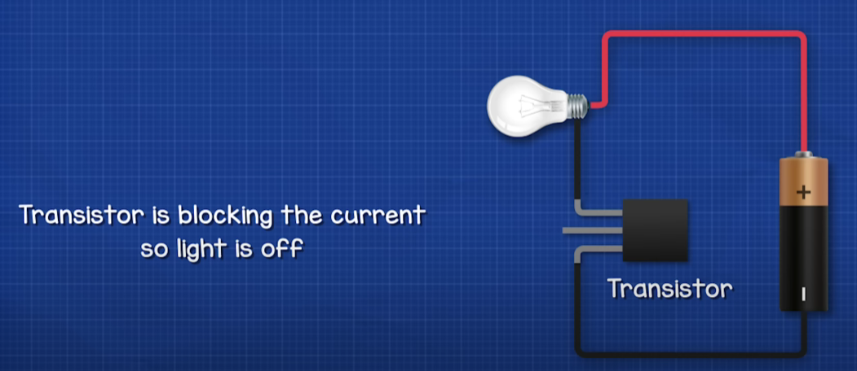
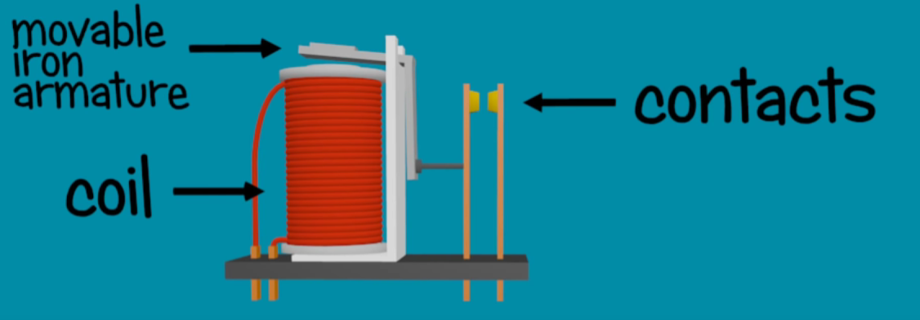
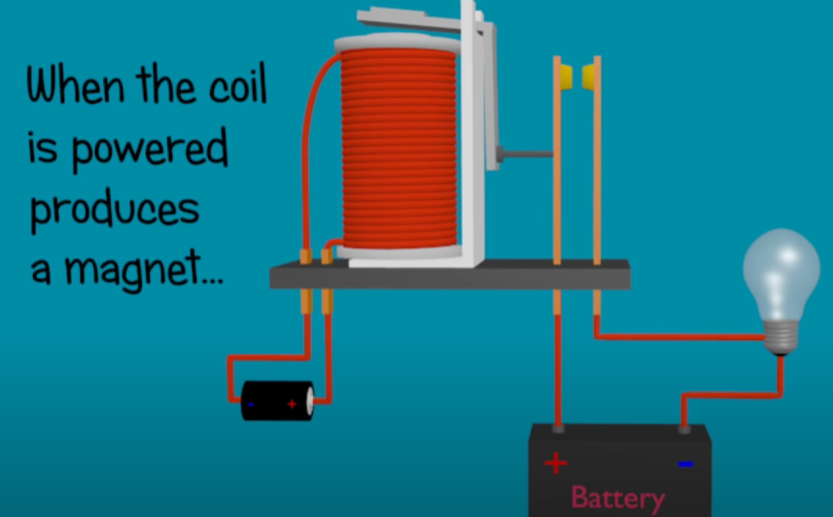
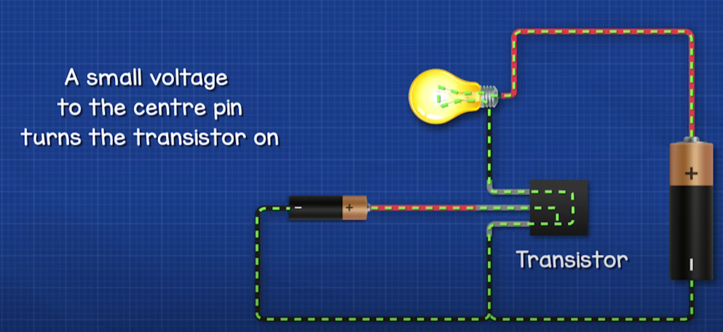
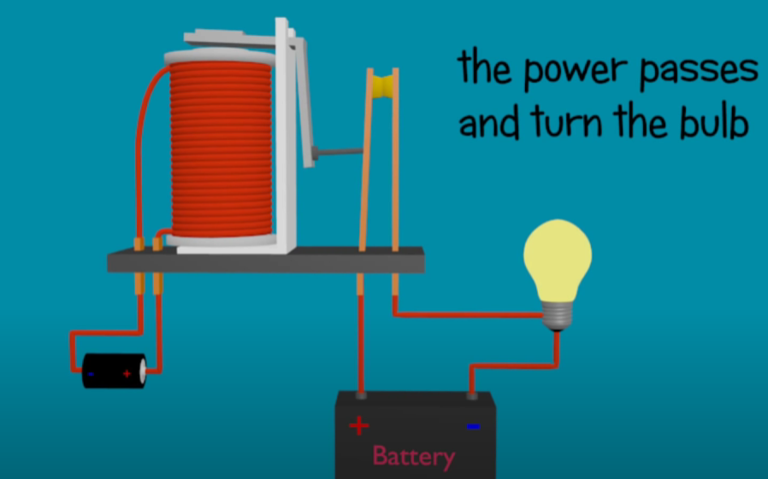

Description of the Work
How Transistor work:
How Relay works

Slide 9
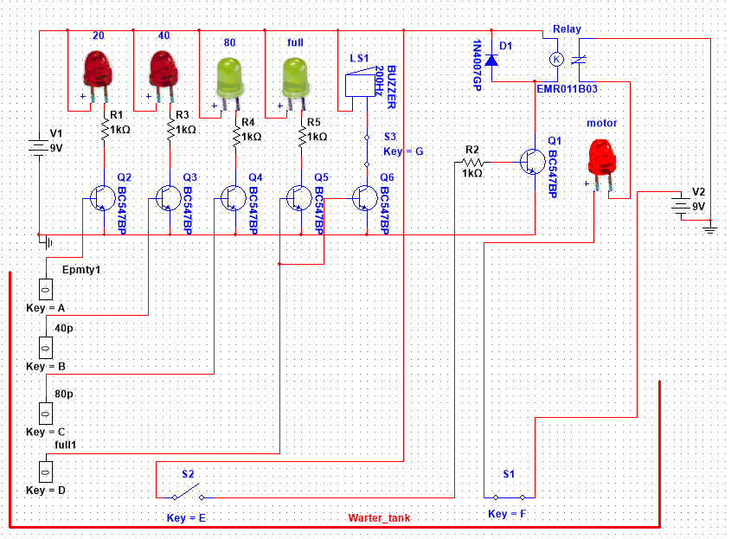
Experimental Setup
Simulation

Slide 10
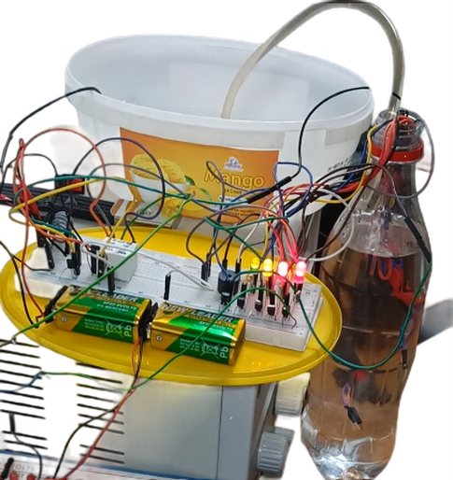
Experimental Setup
Hardware Implementation

Slide 11
Results and Discussions
Successful system build and functionality demonstration.
Testing conducted on a board and in a multisim simulation.
Positive results from tests confirmed system effectiveness.
Multisim simulation mostly aligned with expectations.
Challenges emerged during real-world implementation.
Swift resolution of encountered problems by the team.
Moderate project timeline from start to finish.
Project cost ranged from 400 – 500 Taka.
Affordable production cost makes it suitable for various customers.

Slide 12
Conclusions
The Water Level Indicator project equipped with an Alarm System and an Automatic Off feature has successfully demonstrated its practicality and utility in managing water levels effectively. By using a relay for the automatic shutdown of the water pump, this system ensures optimal water usage, prevents overflow, and mitigates wastage. The integration of an alarm system adds an extra layer of alertness, promptly notifying users about critical water levels and potential issues.
This project holds great significance, particularly in contexts where water conservation and resource management are crucial. Its user-friendly design and automation capabilities enhance convenience while promoting responsible water usage. As such, the Water Level Indicator with Alarm System and Automatic Off is an exemplary innovation that addresses water-related challenges, positively contributing to sustainability and efficient resource utilization.

Slide 13
Future Scopes
IoT Integration: Explore integrating the system with Internet of Things (IoT) platforms for real-time monitoring and control from anywhere via smartphone apps or web interfaces.
Rainwater Harvesting Integration: Extend the project to work in tandem with rainwater harvesting systems, optimizing the use of available water sources and enhancing overall sustainability.
Voice Command Activation: Implement voice recognition technology to enable users to control and monitor the water level system using voice commands, adding a layer of convenience.
Water Quality Monitoring: Including sensors to monitor water quality parameters would provide a more comprehensive solution, alerting users to potential contamination issues.

Slide 14
Thanks for listening our presentation….
?

